Slide 1
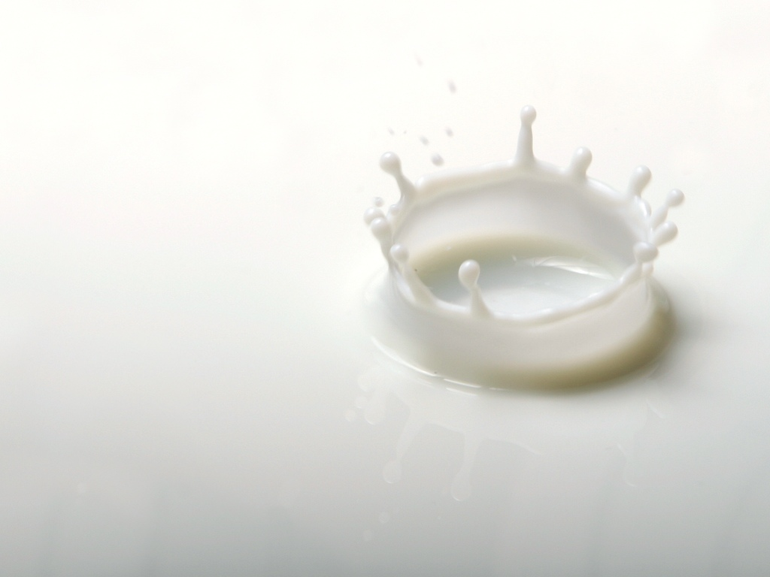
MARKET ANALYSIS: MILK INDUSTRY
GROUP – 12
DIVYA PATEL - 1401030
KRUPA GAJJAR - 1401031
MANSI THAKKAR - 1401036
POOJA LANGHNODA - 1401037
HETUL SHAH - 1401064
AASHIMA YUTHIKA -1401071
NISHI SHAH - 1401099
SHIVANI SHAH - 1401104

Slide 2
PROJECT DEFINITION
In continuation to our first project, we have studied the dairy market in India.

Slide 3
THE MILK INDUSTRY IN INDIA
India is the World’s Largest Producer of Milk. However, the milk industry inside India is in itself, more than 50% in the unorganised sector.
Despite this the market share of India in the Milk Industry in the World is approximately 38%.
We are also the largest consumers of milk and its products.

Slide 4
Despite being the world’s largest producer, the dairy sector is by and large in the primitive stage of development and modernization.
Moreover, the sector is plagued with various other impediments like shortage of fodder, its poor quality, dismal transportation facilities and a poorly developed cold chain infrastructure. As a result, the supply side lacks in elasticity that is expected of it.

Slide 5
MILK AS A FMCG
A Fast Moving Consumer Good is one that is sold quickly and at a relatively Low Cost. Although, the profit margin is relatively small (more so for retailers than producers/suppliers), they are sold in large quantities, thus, the cumulative profit in such products is substantial.
As seen earlier in our previous project, being a perishable good milk is a Fast Moving Consumer Good.

Slide 6
The turnover of the milk industry as 2015 was approximately INR 3 lakhs crore.
A total of approximately 150 million tonnes of milk was produced in India alone in 2015.
The market of Milk is affected largely by the fact that it is a Fast Moving Consumer Good.
This will be seen in the following slides, while analysing the market type of Milk.

Slide 7
MARKET TYPE OF MILK
According to our analysis and understanding, we have concluded that Milk has an Oligopoly Market.
The characteristics of an Oligopoly Market are as follows:
Limited Producers
Pricing Strategy has a key role
Advertisement
Sticky Price
These characteristics are explained for the Milk Industry in the following slides.

Slide 8
LIMITED PRODUCERS

Slide 9
The number of producers in the Milk Market (Dairy Industry) is limited. Here’s a list of some of the major Producers and Suppliers in India.
Gujarat Cooperative Milk Marketing Federation Ltd. (GCMMF)
Kwality Dairy India Limited
Punjab Cooperatives
Mother Dairy India Limited
Vadilal Industries
Modern Dairies Limited
Parag Milk Foods
Dynamix dairy industries limited
Nestle India
Dabone International Pvt. Ltd
Britannia Industries Limited

Slide 10
Out of all these producers and suppliers, AMUL enjoys a major share of the Dairy Industry in India (approximately 42% as of 2015).
Also, apart from these a lot of states in India have followed GCMMF after the success of operation flood, and now have their own cooperative milk societies.
Despite this a large percentage of the Milk Market is with the unorganised sector.

Slide 11
PRICING STARTEGY

Slide 12
The Milk industry is such that, despite the reputation of a company in the market, if it increases its price more than what its consumers can afford, it will result in the decrease in their number of consumers.
It is very clear by the fact that all the companies in this sector, keep their prices very near to each other. Even AMUL, which has a large market share does not increase or decrease its price too much, and relies heavily on its quality products, loyal customer base and advertisement strategies.

Slide 13
ADVERTISEMENT

Slide 14
Being a competitive type of market, the producers and especially suppliers of milk keep trying to lure in more customers, through various socially and emotionally connecting advertisements.
In this way these producers and suppliers try to establish their monopoly in the market.
A very good example of the same is the AMUL girl advertisement that has been going on for more than 40 years now. This has helped AMUL establish itself among the consumers.

Slide 15
STICKY PRICE

Slide 16
It is defined as the resistance of the price of a given product to change, despite such changes in the economy that suggest a different price for the product is more optimal.
Being a Fast Moving Consumer Good, Milk is one such product.
Even though the economy changes in such a way that should impact a higher price rise in for milk, but the price rise is so small that it is almost insignificant.

Slide 17
Over the last decade, in general for all companies in the milk industry the price of milk has changed by either 50p or ₹1 per litre.
This change has not always happened per year. This price change is usually after 2 or 3 years.
The sticky price is a characteristic factor of an oligopoly market as all the producers try and match the price of their competitors such that, they follow suit in decreasing price, but hold back when a competitor increases their price.

Slide 18
REFERENCES
https://en.wikipedia.org/wiki/Fast-moving_consumer_goods
http://www.imarcgroup.com/dairy-industry-in-india
http://foodprocessingindia.co.in/milk-and-milk-products.html
http://www.tutor2u.net/economics/reference/oligopoly-kinked-demand-curve

Slide 19
THANK YOU

